Slide 1


Department of Computer Science and Engineering
AN AI APPROACH ON VEHICLE THEFT DETECTION IN PARKING AREAS WITH AN ALERT MESSAGE
Team Members
GOWTHAM E / 211419104086
HARI LINGA PRADEEP M / 211419104090
MD AAMIR / 211419104165
Guide & Coordinator
Dr.N.PUGAZENDI,ME.,Ph.D.,

Slide 2
Introduction
One of the ways to secure motorcycles from theft. One of the smart security system technologies in the field of transportation is an intelligent security system for motorized vehicles. Several methods of motorized vehicle security systems that are currently being used include facial recognition or facial recognition applied to the vehicle, one of the technologies that has a high enough accuracy where the user must first register a photo of the user's face that must be stored in the database.
One of feature is to provide a notification. Minimize the possibility of vehicle theft, Increase a sense of security to the rider . The method used in this research is to use the literature review method based on previous projects so that this project makes the latest research with novelty from research based on previous research, therefore by reading a lot of previous research it will find problems and future research .
The problem raised in this study is how to reduce crime, by early detection of vehicle owners. Therefore, with the system offered in this study, it will be able to recognize who is the real owner of the vehicle that will be tested on the owner's facial recognition.
The purpose of this study is how to make a proposed system that can make vehicles recognize their owners. Therefore, with a face detection system for the owner of the vehicle, it will be able to reduce crime because it will be able to detect early who is the owner of the vehicle.

Slide 3
Objective of the Project
To develop a project that uses face recognition technology to identify whether the detected face is that of the bike owner or a thief, with the goal of preventing bike theft.
The main goal of this project is to prevent bike theft by alerting the owner or the authorities when an unauthorized person tries to access the bike and send alert message through email and phone message.

Slide 4
Literature Survey
S.No | TITLE | AUTHOR | CONTENT | YEAR
1. | Machine Learning Security: Threats, Countermeasures, and Evaluations | MINGFU XUE, CHENGXIANG YUAN, HEYI WU, YUSHU ZHANG, WEIQIANG LIU | Machine learning has been pervasively used in a wide range of applications due to its technical breakthroughs in recent years. It has demonstrated significant success in dealing with various complex problems, and shows capabilities close to humans or even beyond humans.Instead of focusing on one stage or one type of attack, this paper covers all the aspects of machine learning security from the training phase to the test phase. | 2020

Slide 5
S.No | TITLE | AUTHOR | CONTENT | YEAR
2. | RFE Based Feature Selection and KNNOR Based Data Balancing for Electricity Theft Detection Using BiLSTM-LogitBoost Stacking Ensemble Mode | PAMIR, NADEEM JAVAID, AHMAD ALMOGREN, MUHAMMAD UMAR JAVED | Obtaining outstanding electricity theft detection (ETD) performance in the realm of advanced metering infrastructure (AMI) and smart grids (SGs) is quite difficult due to various issues. The issues include limited availability of theft data as compared to benign data, neglecting dimensionality reduction, usage of the standalone (single) electricity theft detectors, etc. These issues lead the classification techniques to low accuracy, minimum precision, low F1 score, and overfitting problems. | 2022
3. | Energy theft detection using gradient boosting theft detector with feature engineering-based preprocessing | Rajiv Punmiya , Sangho Choe | For the smart grid energy theft identification, this letter introduces a gradient boosting theft detector (GBTD) based on the three latest gradient boosting classifiers (GBCs): extreme gradient boosting (XGBoost), categorical boosting (CatBoost), and light gradient boosting method (LightGBM). While most of existing ML algorithms just focus on fine tuning the hyperparameters of the classifiers | 2021

Slide 6
S.No | TITLE | AUTHOR | CONTENT | YEAR
4. | Electricity Theft Detection Based on Stacked Autoencoder and the Undersampling and Resampling Based Random Forest Algorithm | GUOYING LIN, XIAOFENG FENG, WENCHONG GUO, ,XUEYUAN CUI | Electricity theft has been a major concAn electricity theft detection method based on stacked autoencoder (SAE) and the undersampling and re-sampling based random forest (UaRe-RF) algorithm ern to the secure operation of power systems and the interests of power companies. Due to the different methods and types of electricity theft behaviors, it is difficult to determine the suspicion levels of consumers in the research of electricity theft detection. | 2021
5. | Robust Ensemble Machine Learning Model for Filtering Phishing URLs: Expandable Random Gradient Stacked Voting Classifier (ERG-SVC) | PUBUDU L. INDRASIR, MALKA N. HALGAMUGE, AZEEM MOHAMMAD | As cyber-attacks grow fast and complicated, the cybersecurity industry faces challenges to utilize state-of-the-art technology and strategies to battle the consistently present malicious threats. Phishing is a sort of social engineering attack produced technically and classified as identity theft and complicated attack vectors to steal information of internet users. In this perspective, our main objective of this study is to propose a unique, robust ensemble machine learning model architecture that provides the highest prediction accuracy with a low error rate while proposing few other robust machine learning models. | 2021

Slide 7
Problem Statement
This project has significant potential in the field of security systems and theft prevention.
With the increasing number of two-wheeler vehicles on the road, the need for reliable security systems to prevent theft is becoming increasingly important. This project can provide an innovative solution that uses cutting-edge technology to address this problem.
This involves designing and developing the software system that will use face recognition algorithms to detect and differentiate between the faces of bike owners and thieves.

Slide 8
Proposed System
Two-wheeler theft is a common problem in many countries, causing financial losses for the vehicle owners and security concerns for the society. In this project, we propose a system for two-wheeler theft detection using machine learning and face recognition algorithms.
The system is designed to detect whether the detected face belongs to the owner or a thief by comparing it with the pre-trained images of the owner and thieves. First we Collect a dataset of images containing the faces of bike owners. The dataset should contain sufficient variations of face images in terms of lighting, angles, and backgrounds.
Then Train a machine learning model such as face recognition algorithm like HAAR cascaded using the extracted facial features from the pre-processed images. Implement the trained model into the two-wheeler theft detection system. Whenever an input image is uploaded, the system uses the trained model to predict whether the detected face belongs to the owner or a potential thief. An alarm will sound if the predicted face is that of the thief.

Slide 9
Software / Hardware used
H/W SYSTEM CONFIGURATION:
Processor - I3, I5, I7, AMD Processor
RAM - Above 6 GB (min)
Hard Disk - 500 GB
S/W SYSTEM CONFIGURATION :
Operating System : Windows 8/10
Language : Python
Front end : GUI
IDLE : Python version(3.10.8)

Slide 10
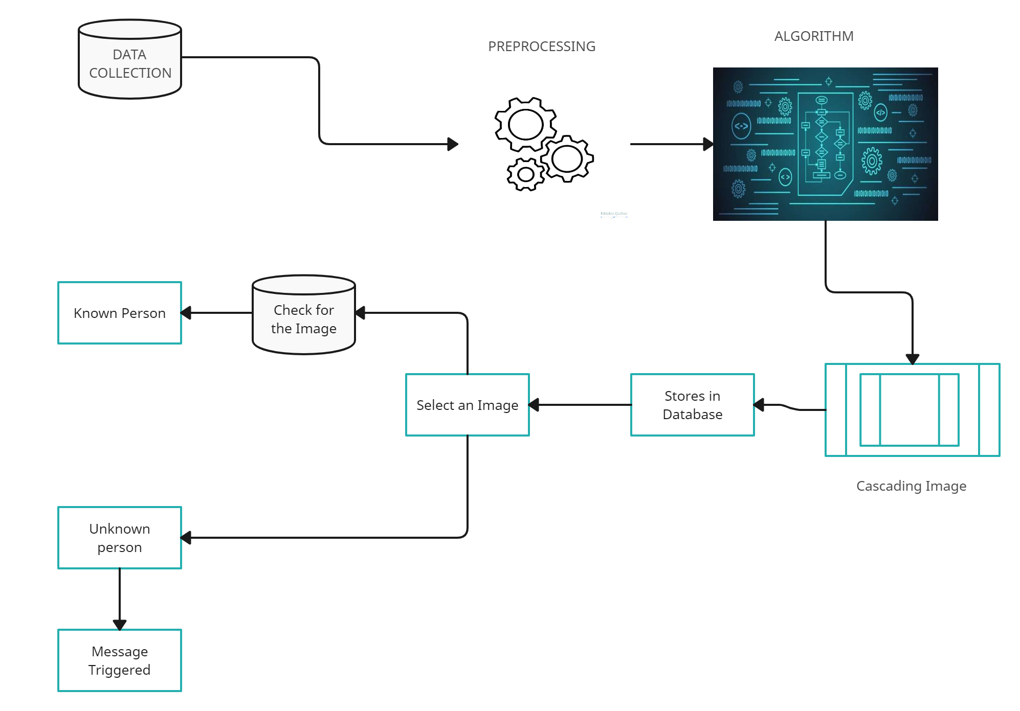
Architecture Diagram

Slide 11
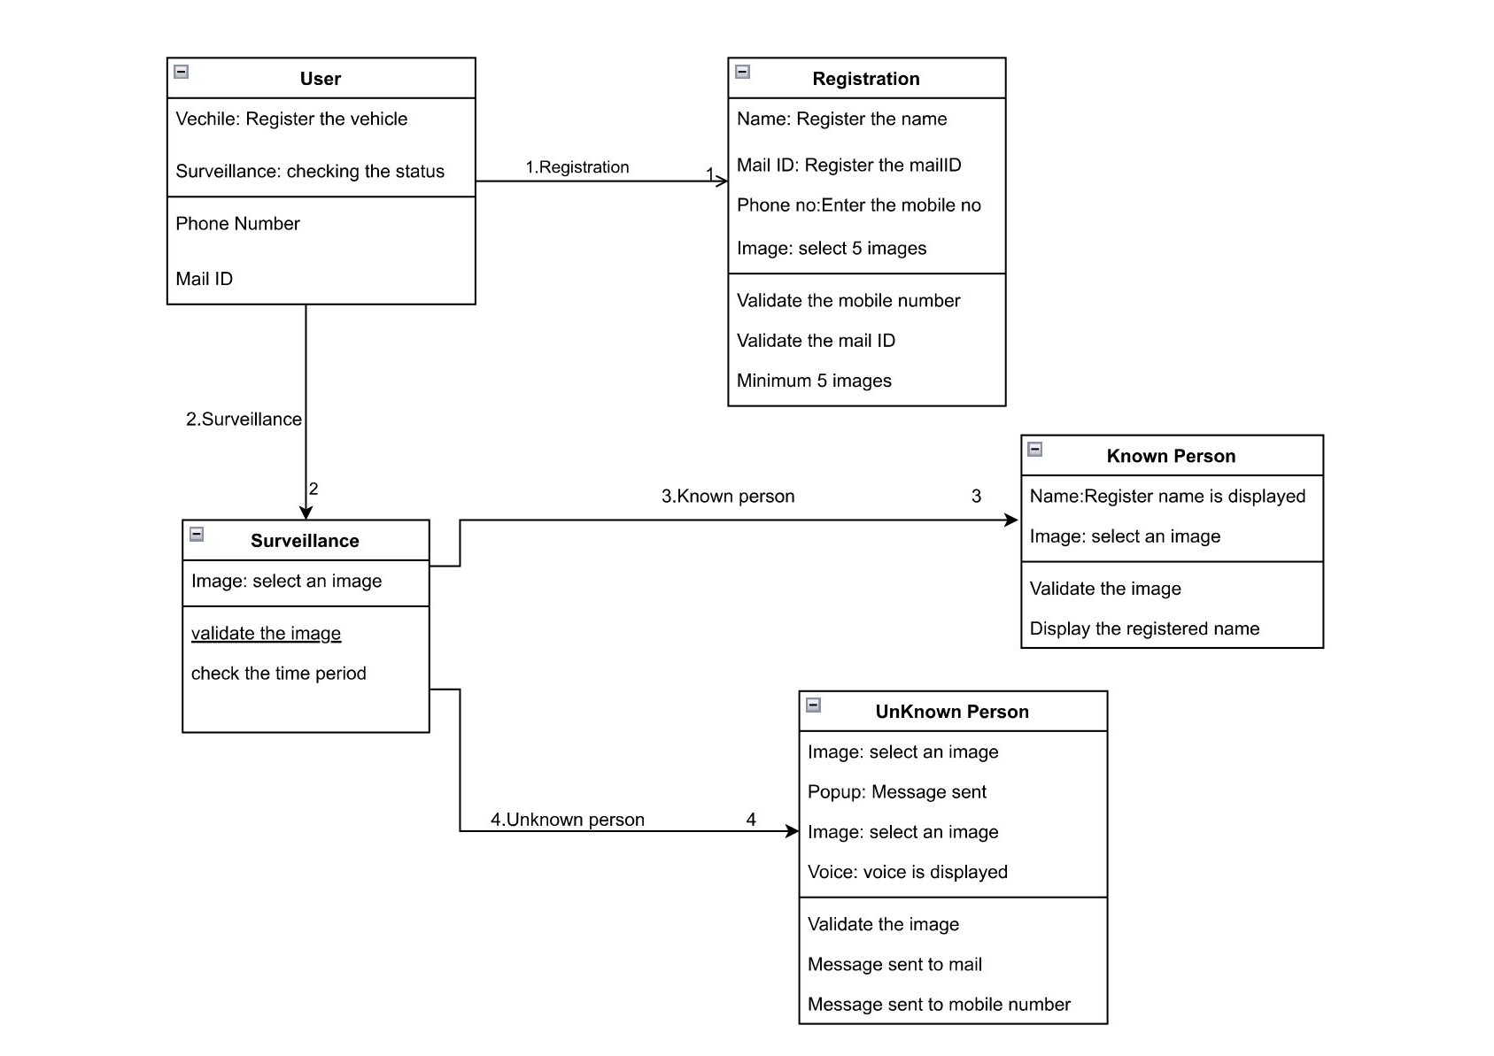
System Design – Class Diagram

Slide 12
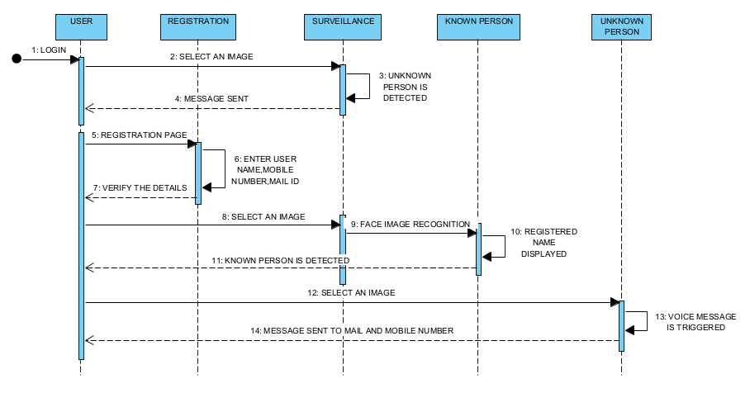
System Design – Sequence Diagram

Slide 13
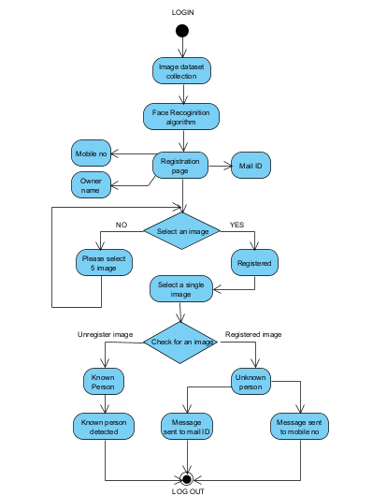
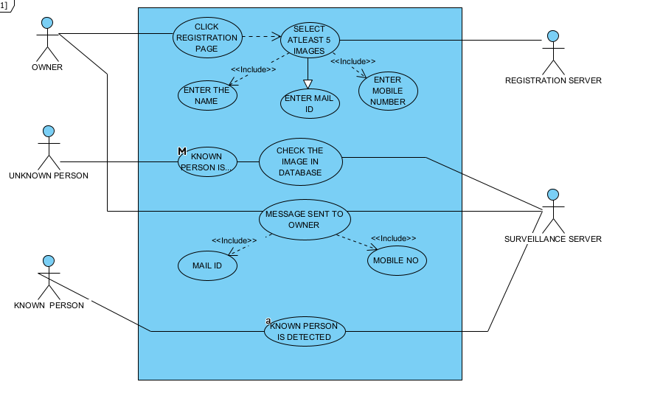
System Design – Activity Diagram and Use case Diagram

Slide 14



Module Description
1.DATASET COLLECTION:
Collect a dataset of images containing the faces of bike owners and potential bike thieves. The dataset should contain sufficient variations of face images in terms of lighting, angles, and backgrounds.
Data collection can be done using various methods such as manual collection, crowd sourcing, or by using publicly available datasets. The manual collection method involves physically collecting images of the two-wheeler owners and potential thieves.

Slide 15





Module Description
2.DATA PRE-PROCESSING:
Data preprocessing is an important step in any machine learning project, including two-wheeler theft detection using face recognition. It involves transforming the raw data into a format that can be used by the machine learning algorithm.
In this project, data preprocessing involves preparing the image data of owners and potential thieves so that it can be used to train the face recognition algorithm. The images may have different sizes, and the algorithm requires images of a fixed size for training. Therefore, the images need to be resized to a common size. The images may contain unnecessary or irrelevant areas such as the background or other objects.
Therefore, the images need to be cropped to focus only on the face. The images may have different brightness, contrast, or color values, which can affect the performance of the algorithm. Therefore, the images need to be normalized to have consistent brightness, contrast, and color values.

Slide 16
Module Description
3.TRAIN ON FACE RECOGNITION MODEL:
Use a deep learning-based face recognition algorithm to train a model on the collected dataset of bike owners' faces. Train an object detection model using the HAAR cascade algorithm.
We can use OpenCV library to implement this. Integrate both models into a single system. When the user uploads an image, the face recognition model should detect the face in the image and compare it with the trained bike owner's faces.

Slide 17
Module Description
4.HAAR CASCADED ALGORITHM:
Haar Cascade is a machine learning-based object detection algorithm used to detect faces or other objects in an image or video stream. The algorithm works by first detecting the features that are common among different images and then using these features to create a classifier.
The classifier is then trained using positive and negative samples of the target object. In our project, the Haar Cascade algorithm can help in detecting unknown faces in the uploaded image. The algorithm is trained to detect faces using features that are common to human faces, such as the presence of eyes, nose, and mouth.
When an image is uploaded to our system, the Haar Cascade algorithm is applied to detect faces in the image. If a face is detected, it is passed on to the face recognition model to check if it belongs to the owner of the bike or not. If the face is recognized as the bike owner's face, no alarm will be sound. However, if the face is not recognized, it is considered an unknown person, and the voice alarm will be sound to alert the user.

Slide 18
Testing
TEST CASE ID | INPUT | EXPECTED OUTPUT | OBTAINED OUTPUT | PASS/FAIL | REMARKS
TC01 | Dataset | Successfully Import | Successfully Import | Pass | Imported Successfully
TC02 | Dataset | Pre-process Successfully | Pre-process Successfully | Pass | Pre-Processed Successfully
TC03 | Image Collection | Image Recognition Successfully | Image Recognition Successfully | Pass | Image Recognised successfully
TC04 | Registration Parameter | Successfully Registered | Successfully Registered | Pass | Registered Successfully
TC05 | Surveillance Parameter | Known Person Is Detected | Known Person Is Detected | Pass | Known Person Detected Successfully

Slide 19

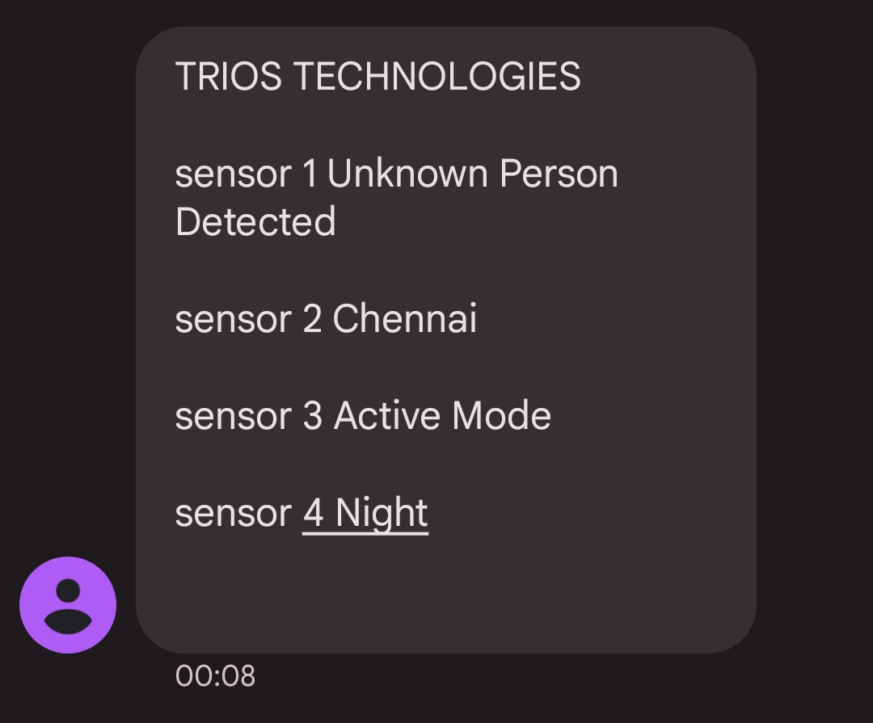
Results
The result of the project would depend on the performance of the face recognition algorithm used and the effectiveness of the alarm and message sending mechanism.
If the face recognition algorithm is accurate and can detect unknown persons with a high degree of confidence, the system would be effective in preventing two-wheeler theft.
Similarly, if the alarm and message sending mechanism works effectively, the bike owner can be alerted quickly, which would increase the chances of stopping the theft.
ALERT EMAIL and PHONE MESSAGE :

Slide 20
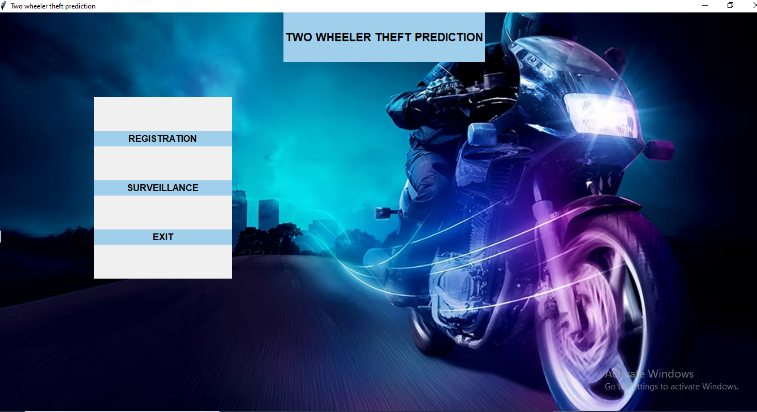
Screen Shots
FRONT PAGE:

Slide 21
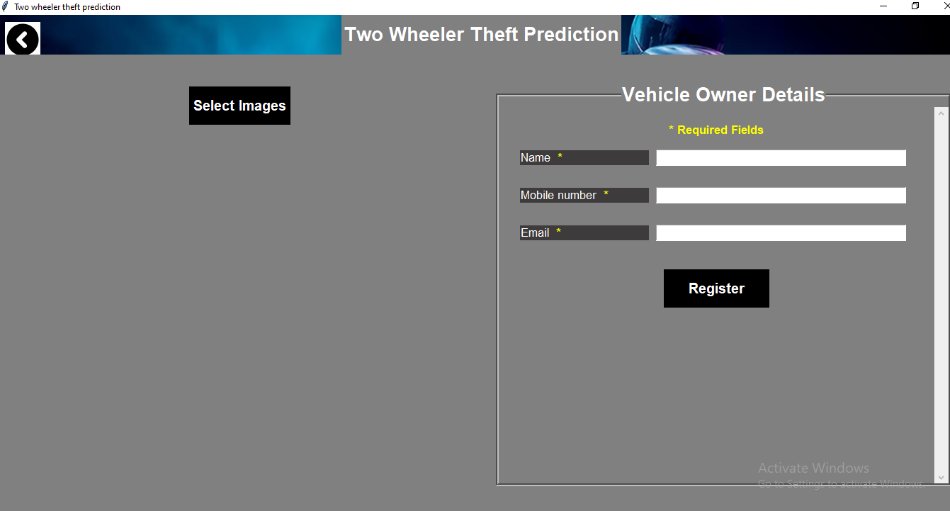
Screen Shots
REGISTRATION PAGE:

Slide 22
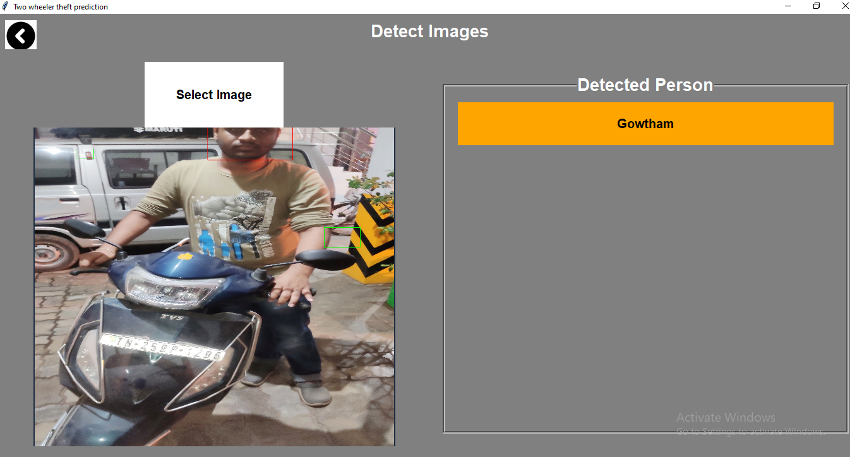
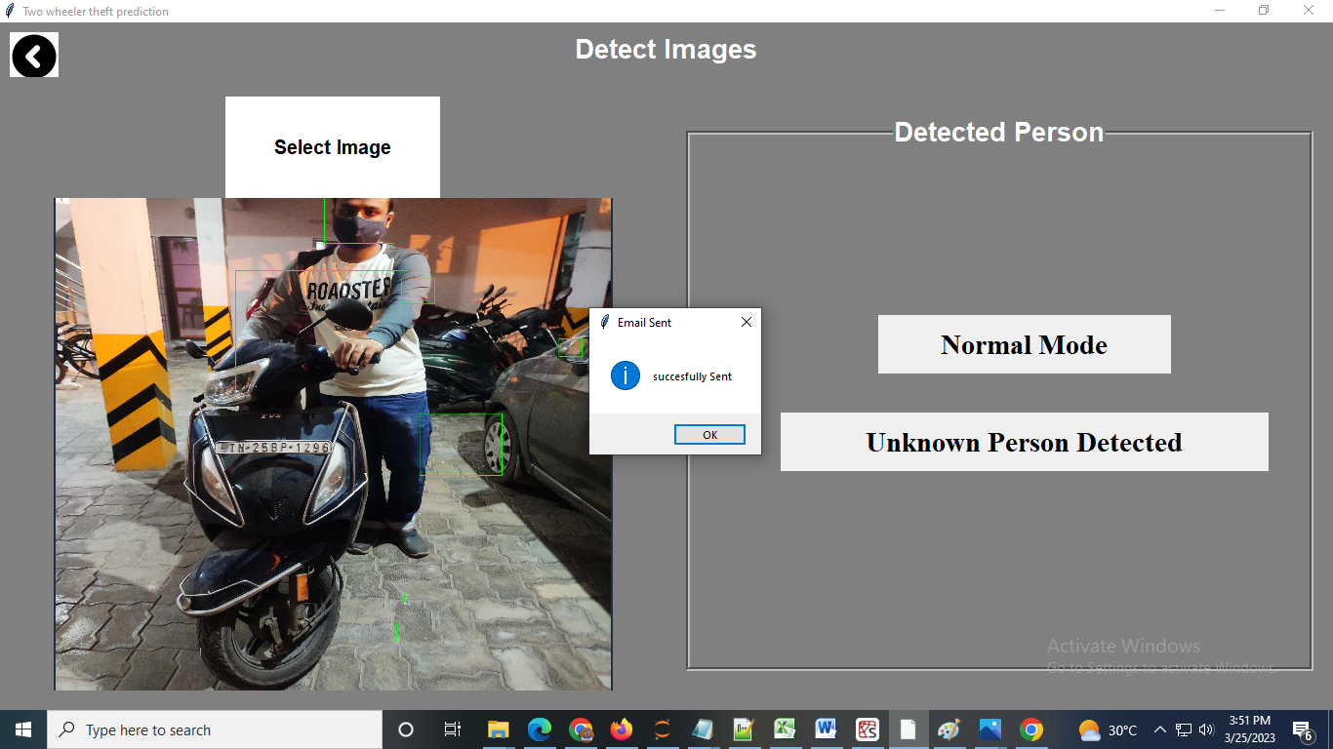
Screen Shots
SURVEILLANCE PAGE:

Slide 23
Conclusion
In conclusion, the proposed system of two-wheeler theft prediction using machine learning has the potential to significantly improve the current crime management system.
The system utilizes face recognition algorithms and Haar cascade classifiers to detect unknown individuals attempting to steal two-wheelers, and send an alert to the owner. This can help prevent the theft of two-wheelers and increase the chances of apprehending the culprit.
The system has been designed and tested successfully, achieving a high level of accuracy in detecting unknown individuals. However, further work can be done to improve the system, such as incorporating additional security measures and refining the prediction algorithm.
Overall, this system can be an important tool in combating two-wheeler thefts and enhancing public safety.

Slide 24
Reference Paper
[1] Z. Yan and H. Wen, ‘‘Performance analysis of electricity theft detection for the smart grid: An overview,’’ IEEE Trans. Instrum. Meas., vol. 71, pp. 1–28, 2022
[2] K. Fei, Q. Li, C. Zhu, M. Dong, and Y. Li, ‘‘Electricity frauds detection in low-voltage networks with contrastive predictive coding,’’ Int. J. Electr. Power Energy Syst., vol. 137, May 2022, Art. no. 107715.
[3] Y. Chai, Y. Zhou, W. Li, and Y. Jiang, ‘‘An explainable multi-modal
hierarchical attention model for developing phishing threat intelligence,’’
IEEE Trans. Dependable Secure Comput., early access, Oct. 12, 2021, doi:
10.1109/TDSC.2021.3119323.
[4] R. Valecha, P. Mandaokar, and H. R. Rao, ‘‘Phishing email detection using
persuasion cues,’’ IEEE Trans. Dependable Secure Comput., early access, Oct.
8, 2021
[5] I. U. Khan, N. Javeid, C. J. Taylor, K. A. A. Gamage, and X. Ma, ‘‘A
stacked machine and deep learning-based approach for analysing electricity
theft in smart grids,’’ IEEE Trans. Smart Grid, vol. 13, no. 2, pp. 1633–1644,
Mar. 2022

Slide 25
Conference / Publication / Project Contest Winner Certificates

